Slide 1


Team 57
United States Naval Academy
Jenny Luo
Ed Gomez
Isaac Cho
Paul Rahner
Notes:
Link to API: https://covidmap.umd.edu/api.html

Slide 2
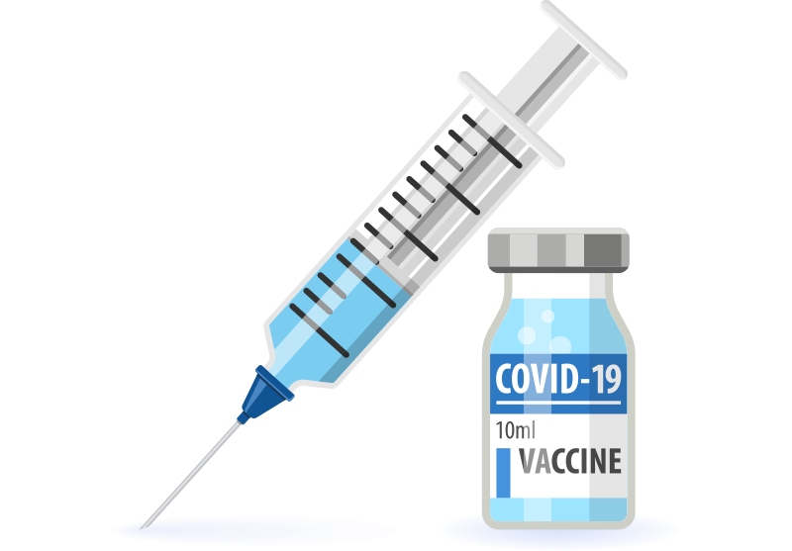


Trends to Explore
SOCIOECONOMIC
Worried about food
Worried about finances
VACCINE
Vaccines received
Vaccine acceptance
COVID DATA
COVID-like illness reported
mask wearing
Sources of trust for vaccine
Notes:
*Hypothetical route we can take* Lookin at these trends here, I said wow some of these countries worried about food a lot while others ain’t so much. So then I ask myself, self would being scared of starving or being poor affect my opinion of covid? Well, since I can’t experience if I would or not, I decided to use the data of certain countries to do see if I could find an answer. I took 3 of the most worried countries, and 3 of the least worried countries and compared their attitudes to covid. What were my criteria/variables I decided to gauge attitude towards covid? Well Vaccine acceptance and mask wearing rates. We found that “Insert findings here”.

Slide 3
Bias and Representation in Our Data and Analysis
Data Concerns
Survey Error-How were survey results obtained? Are samples representative?
Response Bias-Were respondents influenced when providing answers?
Agreement Bias-Are respondents more likely to agree to the vaccine on paper?
We mainly compared difference between countries, so assume similar bias skew
Analysis
Scope Error-There are many variables influencing anxiety and vaccinations. We tried to account for country backgrounds, but there are many other variables that also influence the responses. Ie: Government subsidies toward agriculture may also influence food anxiety
Use percent instead of number so that population size does not skew results

Slide 4
The Focus of Our Search:
OUTLIERS
OUTLIERS

Slide 5

Research Question:
Does social-economics or trust in WHO/government affect vaccination acceptance and eventually vaccination percentages?
First, let’s explore countries with different socioeconomic backgrounds....

Slide 6
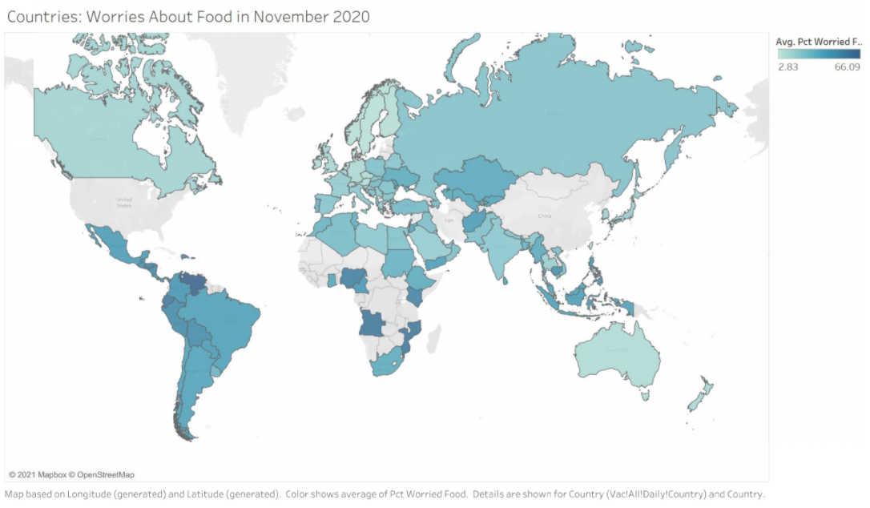
Food Concerns
South America worried about food
Agricultural societies?
British and European countries least worried about food
Industrial societies?
What about Eastern or African countries?
Not sure

Slide 7
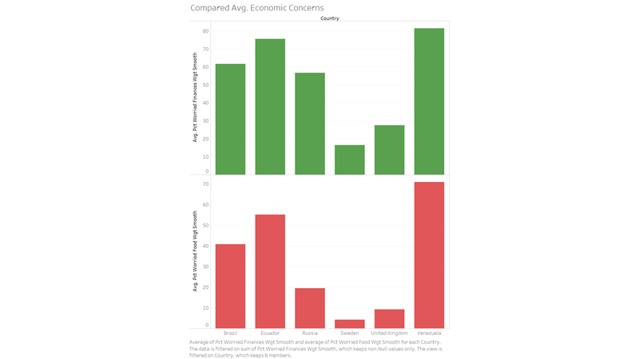
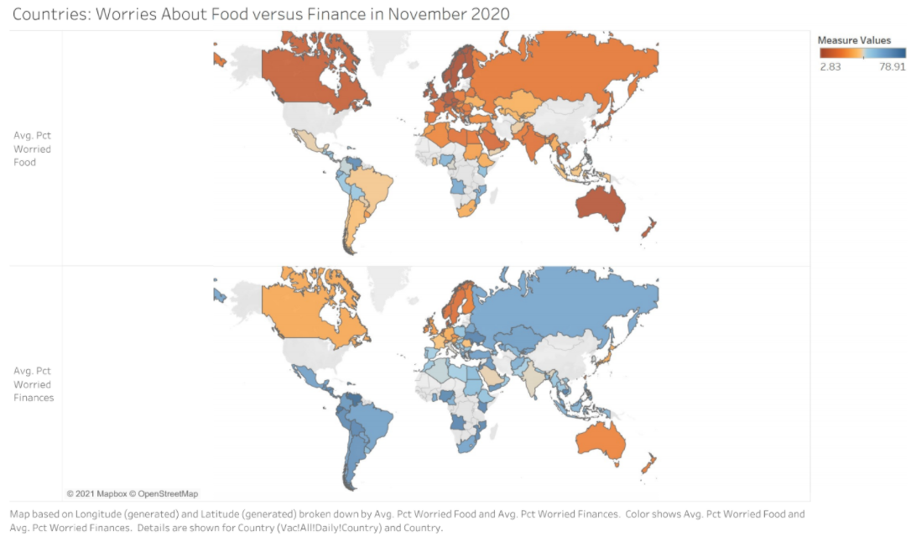
Economic Concerns in Our Focus Countries
Compare Venezuela and Brazil
Compare Sweden and other European countries

Slide 8
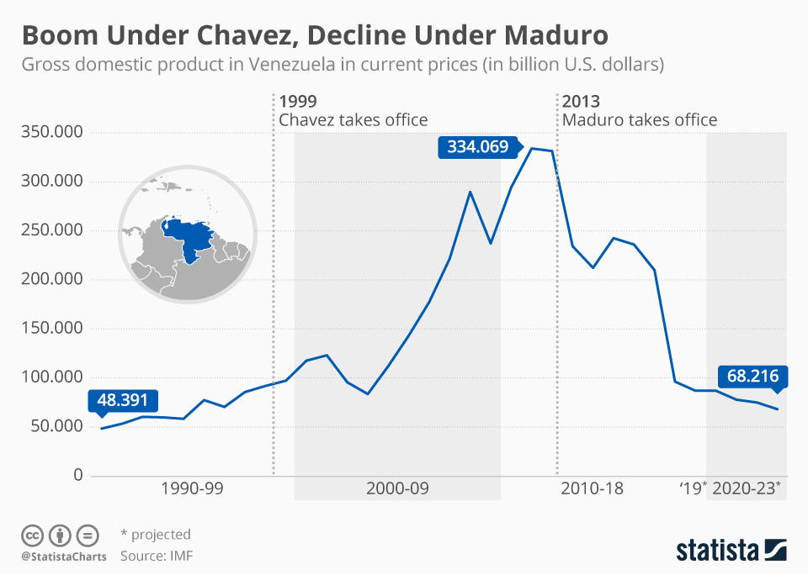
Venezuela Background Affects Population Anxiety
Venezuela’s economy heavily relies on oil exports, but oil supplies have been dwindling and the new leader has not been managing the resources well.
The population has been faced consistently with economic stress
Venezuela up to 81% worried about food
Venezuela up to 86% worried about finances
https://www.statista.com/chart/17366/venezuelan-gdp-from-1990-to-2023/

Slide 9
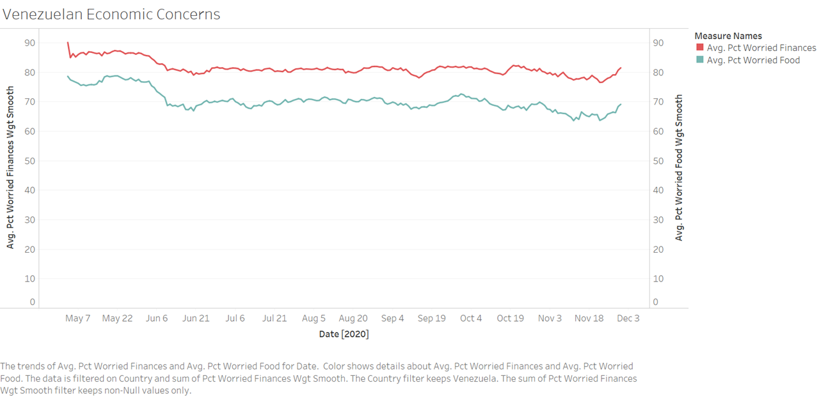
Venezuelan Economy
High of almost 550k people concerned about finances

Slide 10
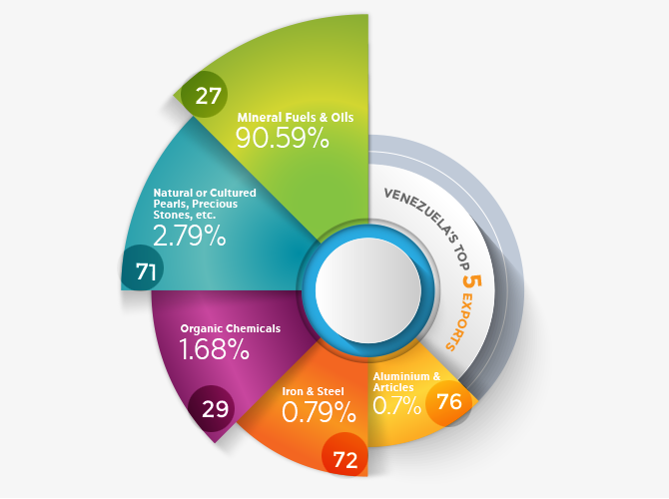
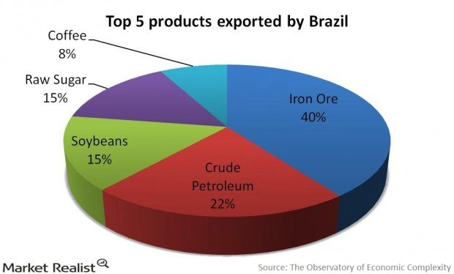
Brazil: A Leader in South American Economy
20-40s% in Food Anxiety < Venezuela’s
Brazil: diversity of exports → high GDP and good economy → Less worries about food (basic need)
vs
https://www.exportgenius.in/blog/venezuela-imports-and-exports-2018-venezuela-trade-data-354.php
http://johnzoletriodejaneiro.weebly.com/exportsimports.html
Venezuela, 2018
90% in oils->imbalanced
Brazil, 2016
Imports oils, export diversity

Slide 11
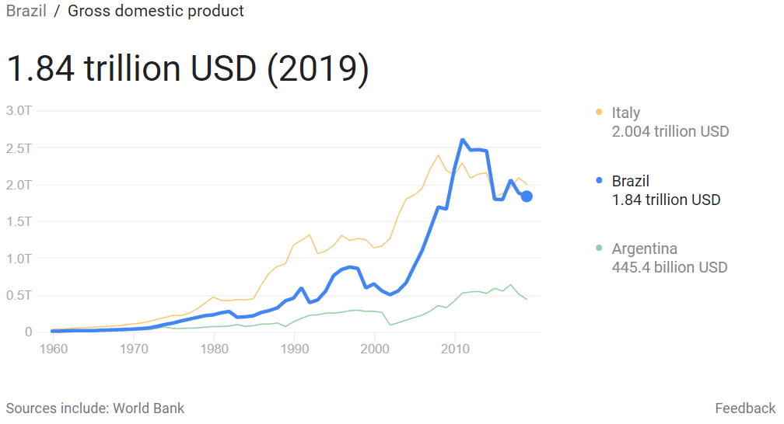
Brazilian Economy
50s-70s% worried about finances
Less than Venezuela but still higher than many countries around the world
Possible cause: recent decade GDP decrease

Slide 12
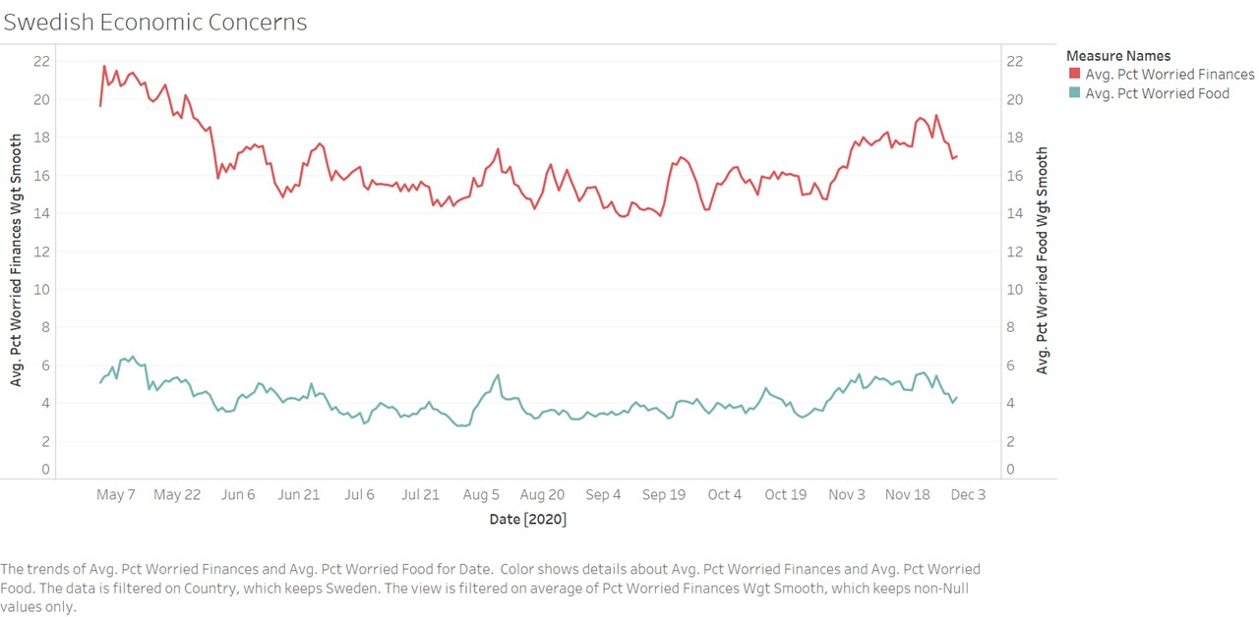
Swedish Econ:
Low Anxiety
Possible Cause: low public debt compared to other European countries
Softer preventive restrictions against Covid than most other European countries (not locked down) --> Economy fared better compared to other countries
https://www.nordeatrade.com/en/explore-new-market/sweden/economical-context

Slide 13
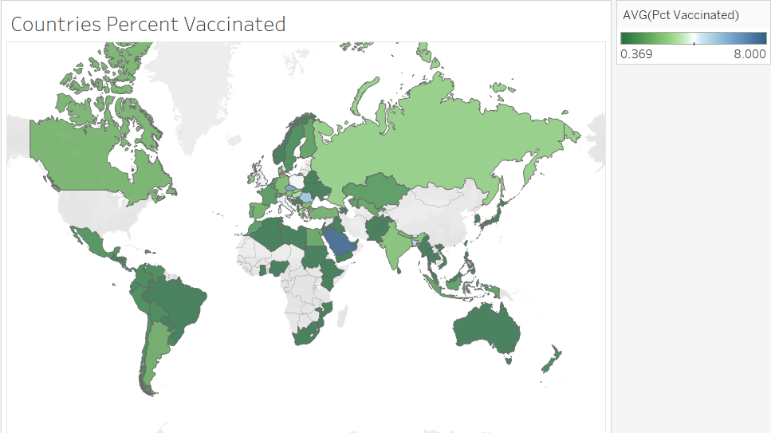
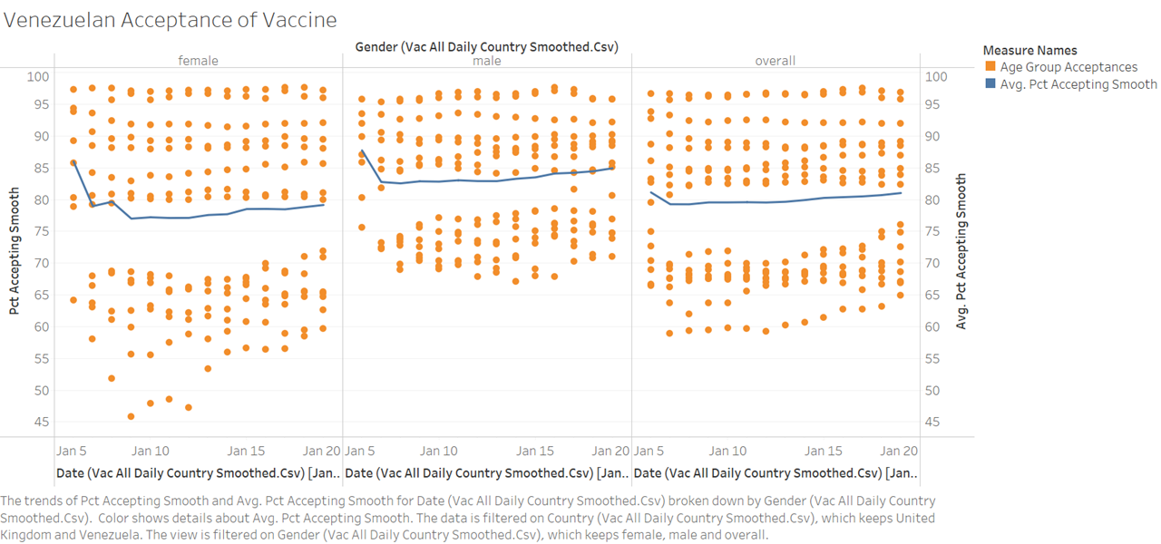
Venezuela: Acceptance
Most Venezuelans are highly accepting of the vaccine
Avg. 80% Acceptance Rate

Slide 14
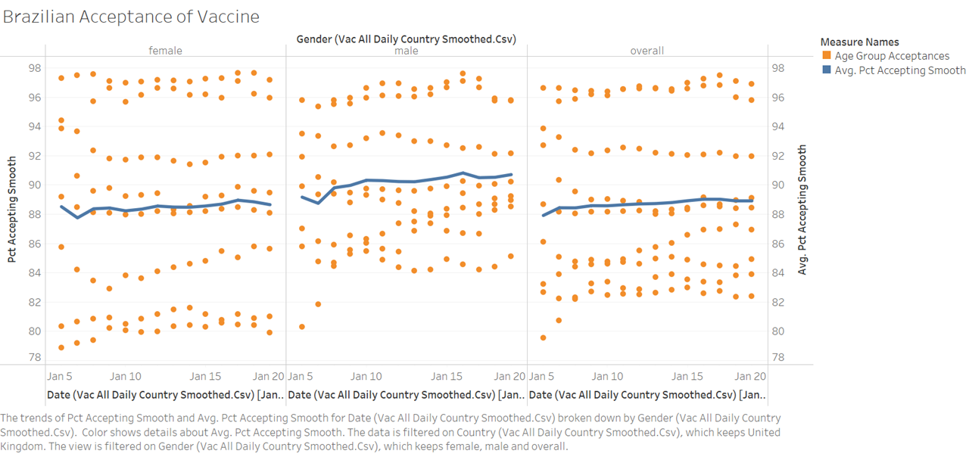
Brazil: Acceptance
Brazilians a little more accepting of the vaccine (~88% >80% Venezuelans)

Slide 15
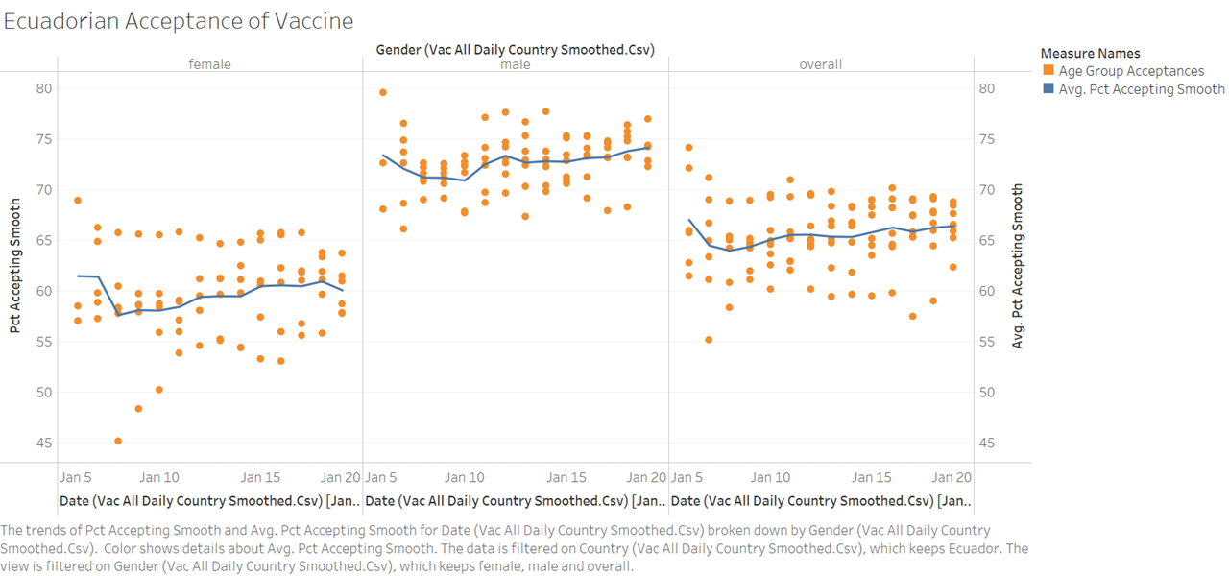
Ecuador: Acceptance
Ecuadorians are less accepting of the vaccine (~70%)
Males slightly more accepting than Females

Slide 16
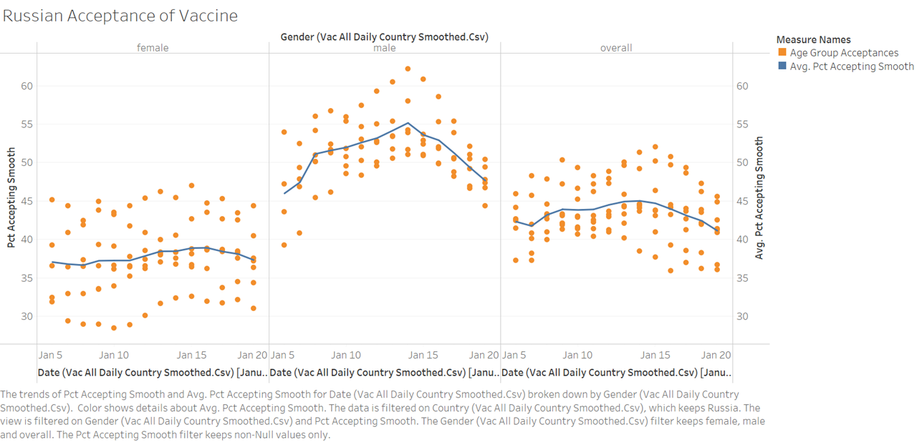
Russia: Acceptance
Male population highly accepting of vaccine; female population is not.
Avg ~40%

Slide 17
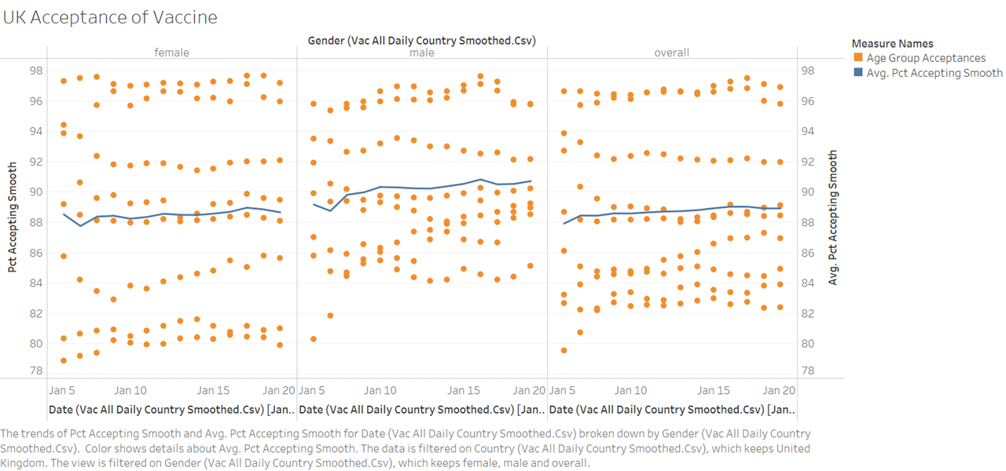
UK: Acceptance
All Brits love the vaccine, cheerio

Slide 18
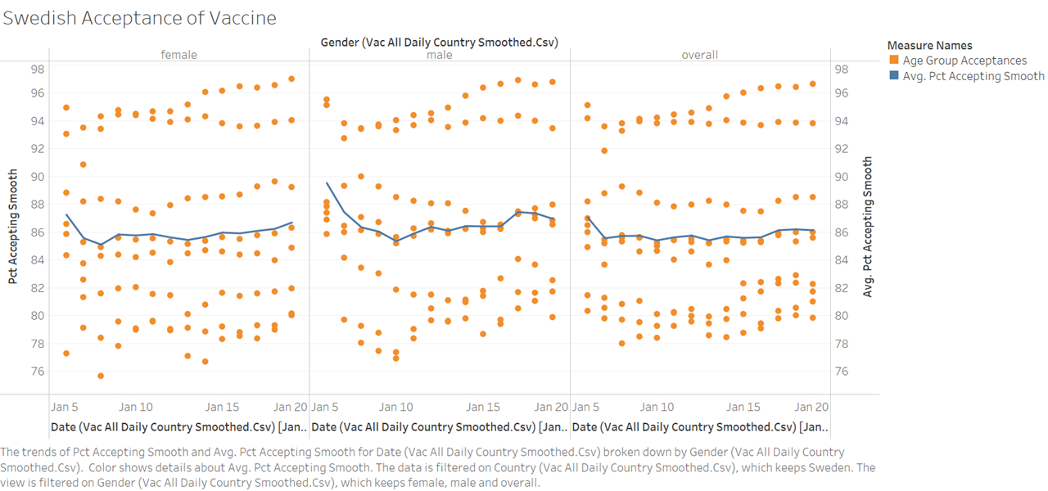
Sweden: Acceptance
General high acceptance of the vaccine due to high COVID-19 cases and lack of Government intervention until Dec. 2020

Slide 19
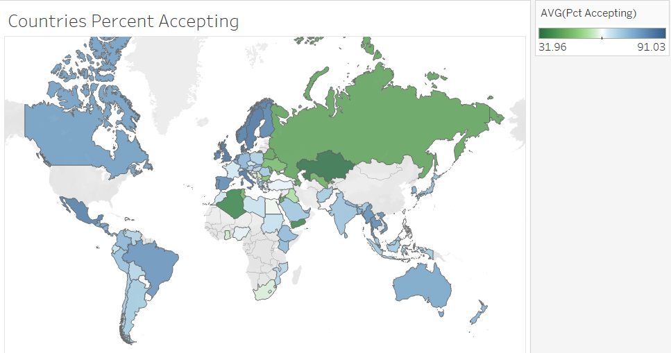
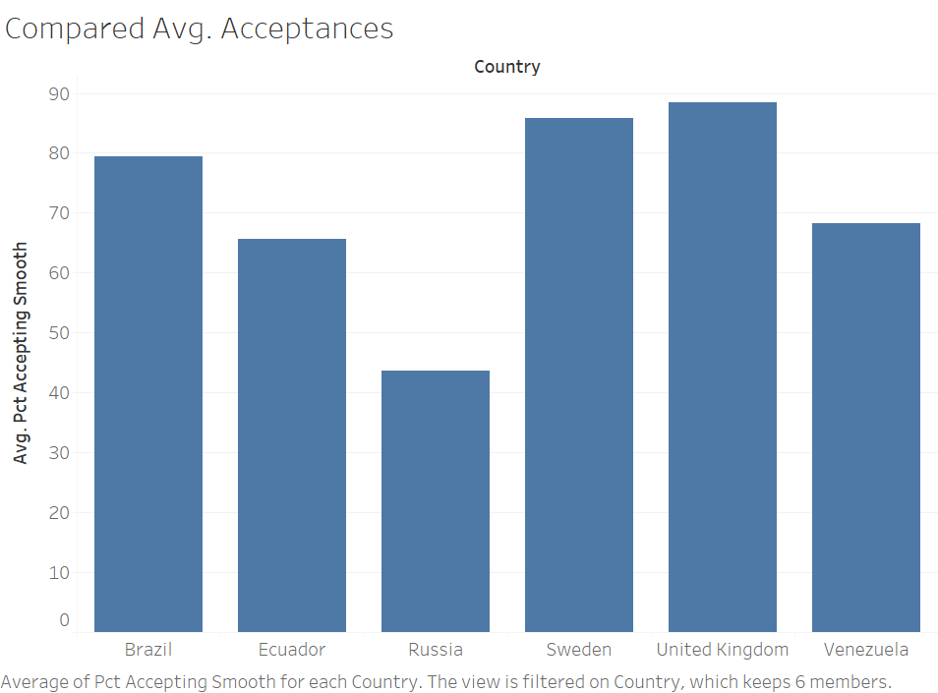
Our previous hypothesis: higher food worries → Higher vaccine acceptance. Disproved, opposite trend seen
Specifically:
VS

Slide 20
Does Acceptance correlate with Percent Vaccinated in these Countries?
We hypothesize yes. If that is true, then socioeconomic factors are also not correlated with percent vaccinated in these countries.

Slide 21
Does Gender Matter?
Only happened in 2 out of 6 of the countries we looked at.
Could attribute to woman having more medical concerns like Pregnancies/etc. So we believe that the slight differences in attitudes towards covid between Genders is inconsequential.

Slide 22
Conclusion on Socioeconomic factors?
There is no correlation and even opposite correlation between socioeconomic factors and vaccine acceptance/administered doses.
Research Question Reminder:
Does social-economics or trust in WHO/government affect vaccination acceptance and eventually vaccination percentages?
Let’s take a look at Israel, where vaccinations are high and see if we can figure out why.

Slide 23
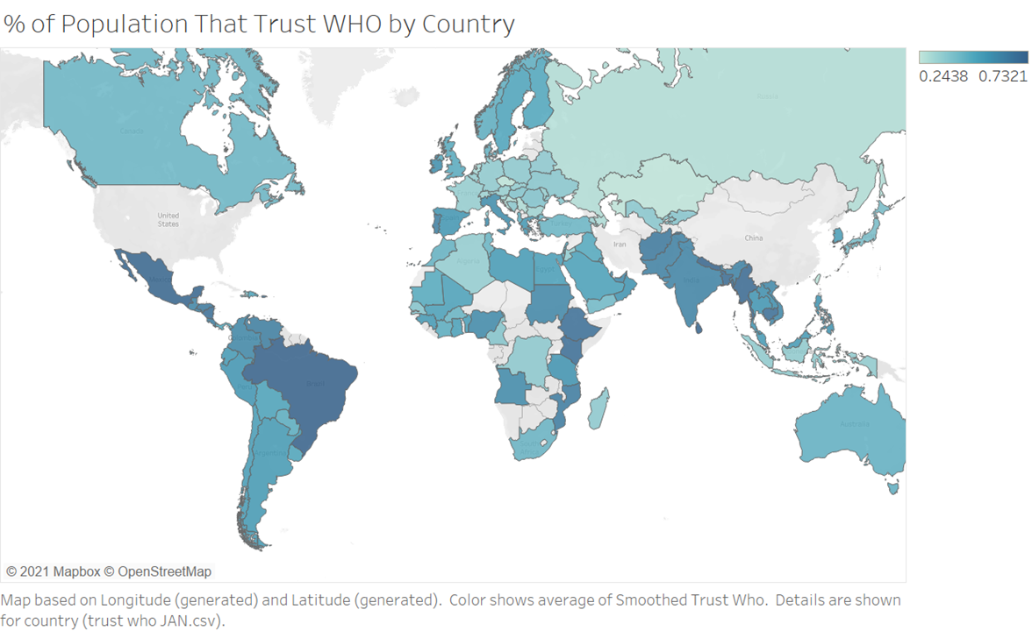
Israel
~50+%
Notes:
RUSSIA

Slide 24
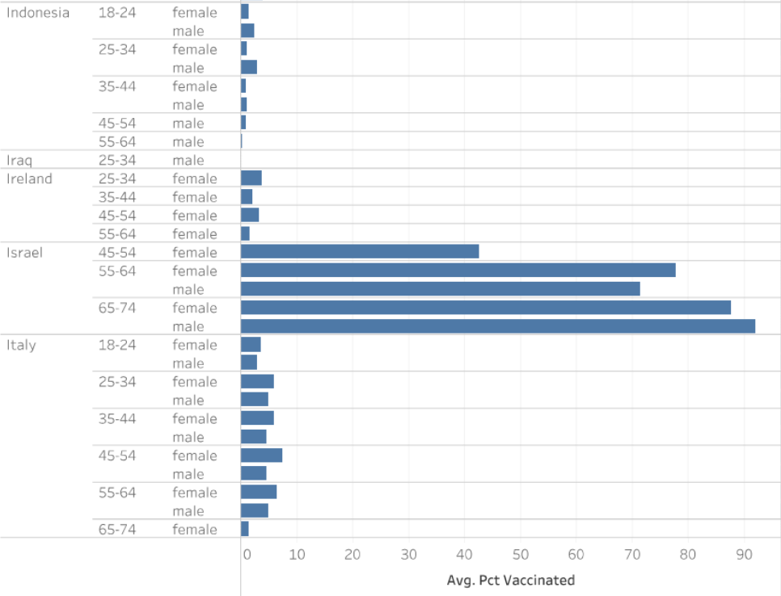
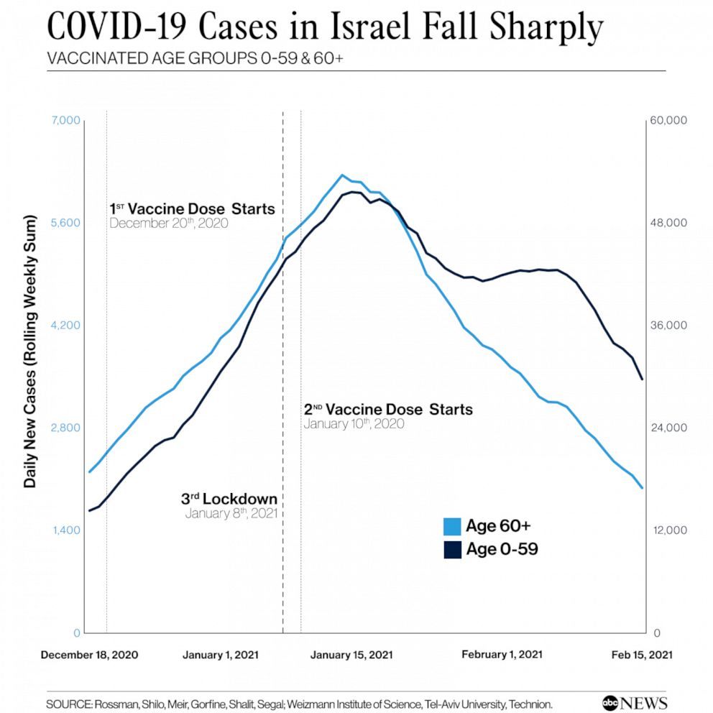
Israel: Extremely High Percent Vaccinated
https://abcnews.go.com/International/countries-learn-israels-covid-vaccine-rollout/story?id=75930083
Vaccinations of older and essential workers first, so that is why older people had high percent vaccinated

Slide 25
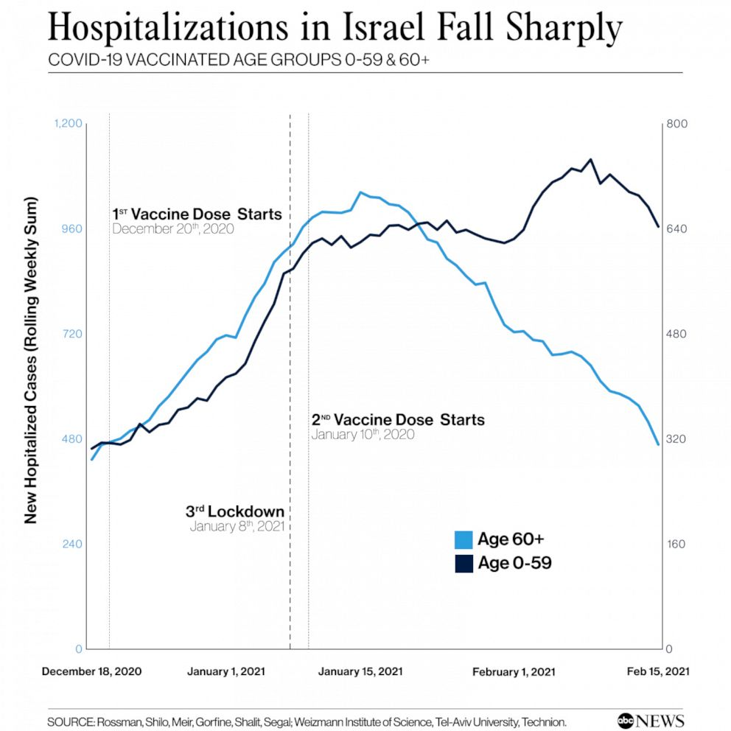
Israel Hospitalizations Also Decrease After Vaccines
Compare younger Israelis who were not vaccinated to the older group who got the second dose
Note of Bias for the Data
Israel went into national lockdown on January 8, 2021. This would have decreased covid cases. However, the difference between the age groups still highlight the effects of the vaccine
https://abcnews.go.com/International/countries-learn-israels-covid-vaccine-rollout/story?id=75930083

Slide 26
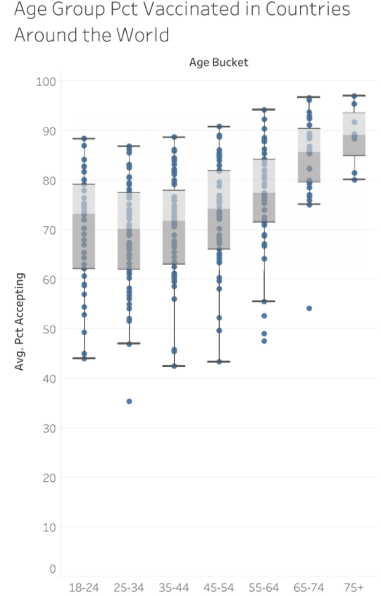
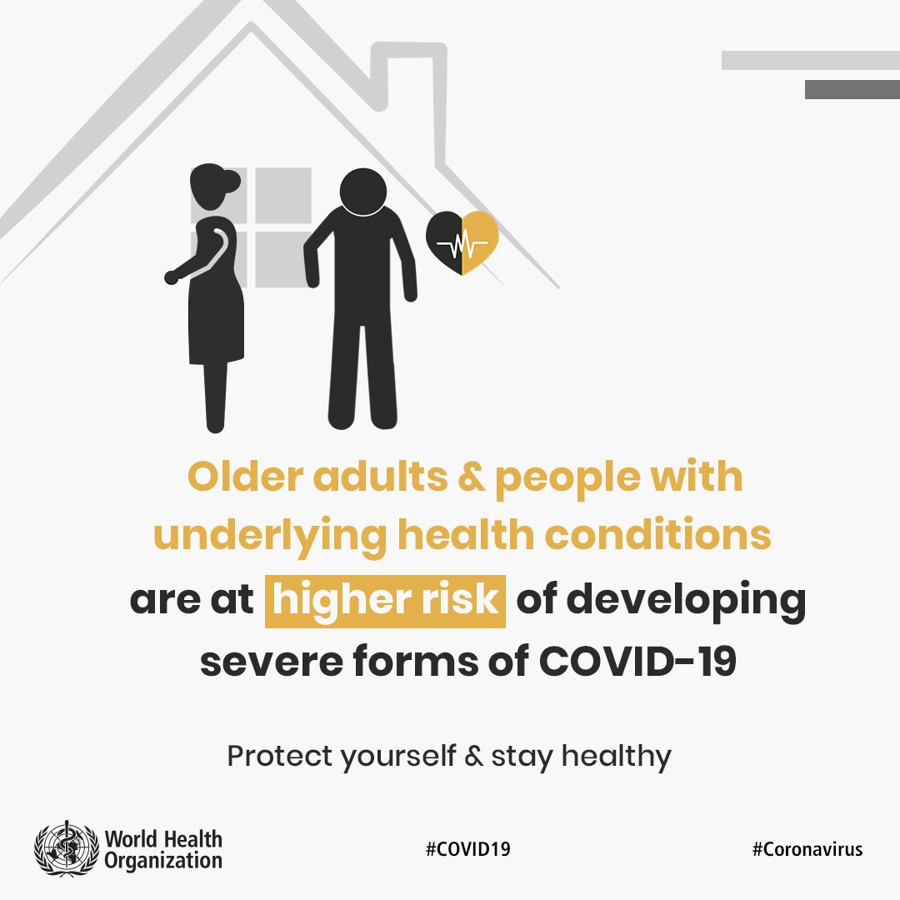
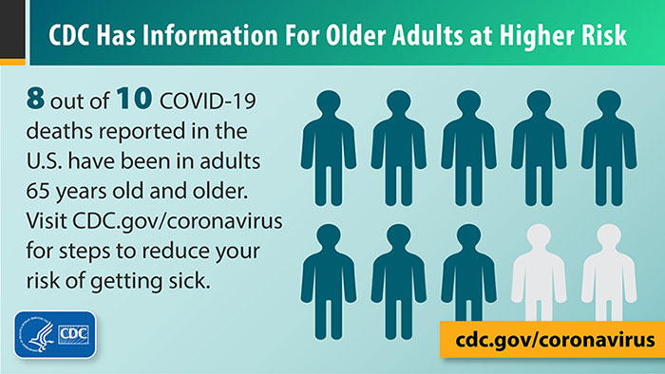
Consensus Around the World
Smaller range for older people
Older people vaccinated earlier
Possible Cause: high urgency for older people and information from health organizations

Slide 27
Research Question Reminder:
Does social-economics or trust in WHO/government affect vaccination acceptance and eventually vaccination percentages?
Now, let’s compare differences in countries’ trust toward covid authority figures (WHO and the government) and acceptance rate....

Slide 28
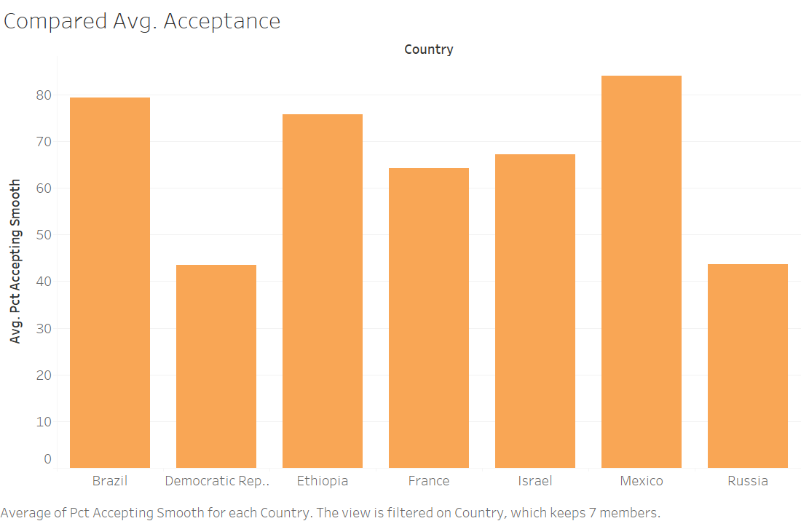
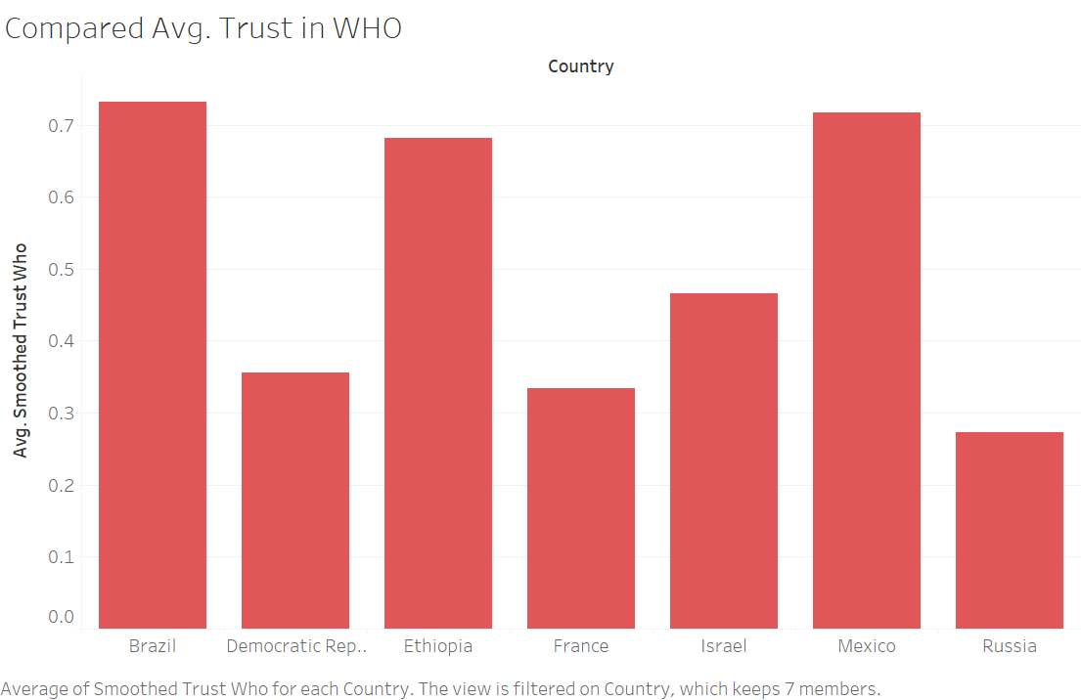

Slide 29
Research Question Reminder:
Does social-economics or trust in WHO affect vaccination acceptance and eventually vaccination percentages?
Conclusion:
Socioeconomic status does not demonstrate a positive correlation to vaccine acceptance.
Trust in the WHO does demonstrate a positive correlation to vaccine acceptance.

Slide 30
Thank You.

